Slide 1
Presenting main findings on implementing PPPs and prepared guidance documents
Knut Gummert, Adviser
European PPP Expertise Centre
European Investment Bank
Tirana, Albania
11 October 2018

Slide 2
Agenda
European PPP Expertise Centre WBIF Assignment
EPEC WBIF Assignment 2016-18
  2.1. EPEC workshops in the Region
    2.2. Main challenges
    2.3. PPP guidance documents
2

Slide 3
1. European PPP Expertise Centre
WBIF Assignment
3

Slide 4

The European PPP Expertise Centre
How could EPEC support you?
1. Share good PPP practice through the network:
  Providing market intelligence
  Addressing practical issues in implementing PPPs
  Developing PPP guidance and tools
2. Assist PPP policy development:
  PPP legal and regulatory frameworks
  PPP institutional arrangements
  Processes for preparation, approving and managing PPPs
3. Support PPP project preparation:
  Early-stage involvement
  Support tailored to individual projects
  High-level strategic advice (‘advising not doing’, ‘working with not for’)
4
Notes:
Who are we?
A unique membership-based PPP expertise network
With a mission to support the public sector to deliver sound PPPs
Based on a membership of 41 (30 countries) – central PPP units of Member States and Candidate countries, the EIB and EC
That benefits from significant Member engagement in EPEC network activities
An integral part of the EIB’s advisory services, providing network activities and advisory support

Slide 5
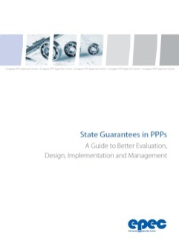

EPEC Reports and Mandated Advisory Services
EPEC provides guidance on various PPP topics…
  Creating and reforming PPP Units
  Value for Money (VfM) assessment
  PPP contract management and the Use of PPP advisers
  Termination and force majeure provisions
  Risk distribution and balance sheet treatment
  Implications of new EU procurement directives for PPPs
…and Mandated Advisory Services
  Implementation of specific subjects and the delivery of defined outputs
  Focused on areas of EPEC’s expertise, benefiting from synergies with other EPEC activities and other advisory service mandates
  Examples include:
  FEMIP region initiatives, most recently MED 5P technical assistance facility
  Western Balkans assignment 1: Legal and institutional frameworks
  Western Balkans assignment 2: Strengthening public sector capacity
5

Slide 6
2. EPEC WBIF Assignment 2016-18
6

Slide 7
The WBIF Assignment 2016-2018
The assignment aims at ‘Strengthening the capacity of the public sector by…
  facilitating the exchange of good practices and lessons learned among public authorities in the Western Balkans and with the EPEC network
  supporting public authorities to assess preparation and ‘market readiness’ of PPP projets
The assignment is based on four components:
1. Component: Assessing finalised and cancelled PPP projects to identify good practices and common challenges (review)
3. Component: Developing PPP guidance documents - project selection, Value for Money assessment, and PPP preparation and procurement
2. Component: Strengthening the capacity of public authorities in preparing PPP, using the Project Preparation Status Tool (PPST)
4. Component: Guide to the preparation of procurement documents and overview of the main clauses of the PPP contract
7

Slide 8
2.1 WBIF workshops on
PPP preparation and procurement
8

Slide 9
EPEC workshops in the region in 2017 and 2018
  1. National capacity building workshops in 2017 on preparing PPP projects:
  Content: These workshops have been based on the Project Preparation Status Tool (PPST) which supports procuring authorities in preparing sound PPP projects by providing a checklist “to do” with the aim to identify gaps in the preparation process.
  Meetings: The workshops were followed by one-to-one meetings with project teams (discussing projects in the energy, transport, waste, education, health sector)
  Time: Workshops were held in Tirana (in May 2017), Belgrade (in June), Pristina (in Sept.), Sarajevo and Banja Luka (in Sept.) and Skopje (in Nov.)
  2. National dissemination workshops in 2018 to present:
  Main findings, challenges and recommendations
  Guidance documents on PPP project preparation and procurement prepared by EPEC to support public officials in the Region
9

Slide 10
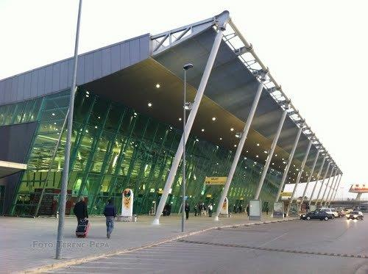


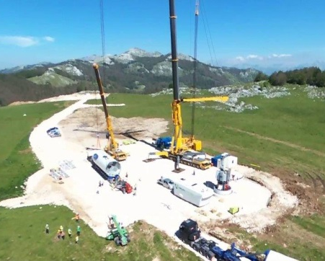

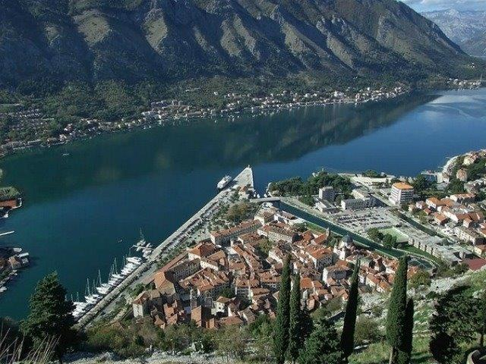

2.2 Main challenges and recommendations
10
Notes:
Examples of discussed projects:
Airports in Pristina and Tirana; windfarm, cable car in Cetinje in Montenegro

Slide 11
Good practice, Challenges and Lessons Learnt
This report summarises the key findings and recommendations drawn from meetings and workshops. The document provides:
data on PPP projects undertaken in the Western Balkans and a summary of the legal and institutional frameworks in the Region;
an assessment of a sample of 10 PPP projects implemented in the Region, analysing the processes adopted by the public authorities; and
key lessons drawn from the exercise and proposes a number of recommendations to address the main challenges identified.
11

Slide 12
Main challenges and findings to delivering PPPs in the Region:
  Institutional arrangements would benefit from a clearer definition of roles and responsibilities and the allocation of dedicated resources
  Limited evidence that the identification of projects and the decision to use PPPs follow a systematic process of assessment for suitability (VfM)
  Major PPP projects generally demonstrate good practice in project preparation and procurement phases
  Appointing suitably experienced PPP transaction advisers brings added benefits to the preparation of projects
  The early involvement of MDBs can bring valuable assistance to the preparation of projects
  The local banking and financial markets lack capacity to undertake large-scale project finance contracts
  Local construction companies often lack capacity and financial/legal knowledge to bid for large-scale infrastructure projects
  Unsolicited proposals from the private sector might not deliver VfM
12

Slide 13
Main recommendations (1)
  1. Policy, legal and institutional frameworks
  Strengthen institutional framework by, e.g. establishing dedicated national PPP units to support public authorities to develop and implement PPPs
  Development of guidance on how to manage unsolicited proposals
  2. Public sector capacity and processes for project preparation
  Develop national infrastructure plans and prioritised (PPP) project pipelines
  Offer capacity building to officials involved in PPP projects to strengthen project preparation, e.g. suitability / VfM assessments
  Implement a more systematic approach to assessing the suitability of projects to procure them through a PPP mode
  Develop guidance on how to use PPP transaction advisers (e.g. standardized contracts)
  Use of technical support available by MDBs and the EU
13

Slide 14
Main recommendations (2)
  3. Market supply and financing
  Use national/regional fora for public and private sectors to exchange information, knowledge and practice on using PPPs
  Collaborate with experienced countries in the EPEC network
  4. Funding and finance
  Consider TA and grants from the EU, e.g. the Western Balkan Investment Framework
  Provide guidance for the systematic recording at the central government level of future potential liabilities arising from PPP contracts
14

Slide 15
2.3 PPP guidance documents
15

Slide 16
Guidance documents throughout the project life cycle:
Phase 1
Phase 2
Phase 3
Phase 4
Project identification
Project preparation
Project procurement
Project implementation
A Guide to the Qualitative and Quantitative Assessment of VfM in PPPs
A Guide to Preparing and Procuring a PPP project
PPP Procurement Handbook
A Guide to the Main Provisions of an Availability-based PPP Contract

Slide 17
Guide to Preparation and Procuring a PPP project
The guidance has been devised in a way that makes it accessible to public officials at the national and regional level, dealing comprehensively with the principal components of the project cycle with an emphasis on European practice and procurement processes.
PPP officials may use this document:
as an introductory guide to project preparation and procurement issues in PPPs;
as a resource to learn more about general aspects of PPP arrangements; and
as an introduction to the typical issues that arise when working with PPP advisers.
17

Slide 18
Guide to the Qualitative and Quantitative Assessment of VfM
This document provides guidance on officials on how to conduct a qualitative and quantitative assessment of VfM. The document:
provides an introduction to VfM assessment;
explains how to carry out a qualitative VfM assessment based on a checklist to asses the suitability of project characteristics and the general framework to procure a project as a PPP;
presents comparative quantitative VfM assessment approaches, including guidance on the use of a public sector comparator and to conduct a risk analysis; and
Includes links to additional literature.
18

Slide 19
PPP Procurement Handbook
This handbook provides more detailed guidance on the conduct of the procurement phase of the PPP project cycle:
It explains the features that would typically be included in the pre-qualification information documents and tender invitation documents issued by the public authority.
It provides comprehensive guidance on the local laws in the Western Balkans that apply to the procurement of a PPP project.
The practices described are consistent with current good practices applied by public authorities throughout the EU and would be recognisable to the European PPP bidding community.
19

Slide 20
Guide to the main provisions of an availability-based PPP contract
This document provides guidance on the main provisions of an availability-based PPP contract.
It is based on good practice from other EU PPP markets.
The guide considers the context and legislative environment for PPPs in the Region and provides comprehensive guidance on the local laws that apply to each aspect of the contract with extensive references to the relevant legislation and regulations.
20

Slide 21
European PPP Expertise Centre
epec@eib.org
www.eib.org/epec
Twitter: @EpecNews
Fernando CRESPO DIU
Principal Adviser
f.crespodiu@eib.org
+352 43 79 83 696
Knut Gummert
Adviser
k.gummert@eib.org
+352 43 79 82 757
21

