Slide 1
A Guide to Preparing and Procuring PPP Projects
Fernando Crespo Diu, Principal Adviser
European PPP Expertise Centre
European Investment Bank
Tirana, Albania
11 October 2018

Slide 2
Agenda
Introduction to the Guide to Preparing and Procuring a PPP Project
Phase 1 – Project identification
Phase 2 – Project preparation
Phase 3 – Project procurement
Final comments

Slide 3
1. Introduction to the Guide to Preparing and Procuring a PPP Project

Slide 4
Content of the Guide to Preparing and Procuring
Presents current good practice from the European PPP market relevant to the public officials in the WB Region
Aims to provide a framework for decision making during preparing and procuring a PPP project
Presents key issues to be considered when performing the activities within three phases of the project lifecycle
Provides additional references of key documentation (EPEC, European Commission, etc)
Find here the document

Slide 5
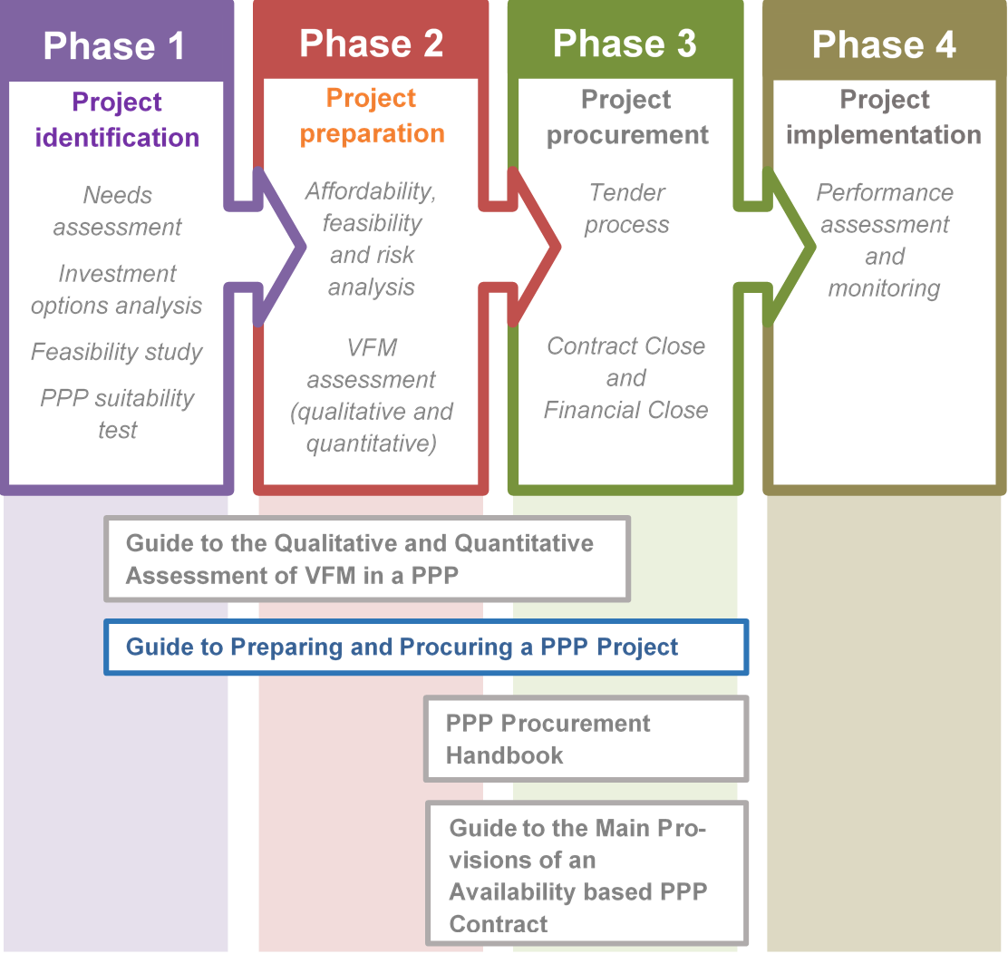
The Guide to P&P in the PPP project lifecycle:
This document

Slide 6
2. Phase 1 – Project identification

Slide 7
Phase 1 – Project identification
First phase of project lifecycle when public authorities must determine if a project is:
Technically, financially and economically feasible (Stage 1); and
Suitable for procurement through a PPP (Stage 2). This stage often includes an initial assessment to determine whether a PPP is likely to deliver better VfM than a traditional procurement approach.

Slide 8
Phase 1 – Project identification
Phase 1 Project Identification
Stage | Step | Activity
Project identification and selection | Needs assessment | Conduct needs assessment
 | Investment option analysis | Collect data and information on the objectives and scope of the project Determine appropriate investment options
 | Feasibility studies | Assess the technical, financial and economic feasibility of the project concept (e.g. Cost Benefit Analysis) Conduct an economic viability analysis (e.g. a cost effectiveness analysis)
 | Initial assessments | Affordability Risk allocation Accounting treatment Bankability
Appraise suitability of project as a PPP | PPP suitability appraisal and initial qualitative VfM assessment | Assess a project's suitability for procurement through a PPP by examining project characteristics and framework conditions Initial qualitative VfM assessment

Slide 9
Phase 1 – Project identification
Stage 1 – Project identification and selection
Planning and prioritising investment in public infrastructure through investment plans, public and transparent
Needs assessment for specific investment within a given investment framework
Economic Cost-Benefit Analysis (ECBA)
Investment options analysis, range of technical and legal options
Political support and stakeholder consultation, achieve public support, market sounding
Pre-feasibility study, in technical, legal, financial, social and environmental terms

Slide 10
Phase 1 – Project identification
Stage 2 – Appraise suitability of PPP to deliver project
PPP suitability test, determine if a project has the elementary characteristics to be procured as a PPP
Aims at discarding unsuitable projects, not to identify the most suitable ones
Largely qualitative approach
Approach might vary from country to country and across sectors

Slide 11
Phase 1 – Project identification

Slide 12
3. Phase 2 – Project preparation

Slide 13
Phase 2 – Project preparation
The public authority sets up the governance structure for the project and conducts more in-depth analyses of key issues:
Value for Money (VfM) assessments
Affordability (financial and fiscal) analysis
Risk analysis, allocation and mitigation measures
Preparation of tender documents, technical specifications, Terms of Reference, minutes of contract
Final result of this phase: public authority ready to start the public procurement phase

Slide 14
Phase 2 – Project preparation
Phase 2 Project preparation
Stage | Step | Activity
Managing and planning the process | Set up project team and governance structure | Set up the project management team Define the PPP project governance structure
 | Engage team of transaction advisers | Identify the expertise needs of the public authority team; then Select the advisers to meet these needs
 | Develop project plan and timetable | Identify the project activities and the critical path Develop a detailed project plan and timetable
Developing the PPP Project | Project appraisal process | Feasibility studies: scoping and structuring the project Affordability assessment Value for Money assessment Risk analysis and allocation Finance-ability and bankability assessment Market assessment
 | Statistical classification of contract | Introduction to statistical approaches

Slide 15
Phase 2 – Project preparation
Stage 1 – Managing and planning the process
Good practice to create a “steering committee” (supervise and decide on matters related to the process) and a “project team” (developing work and managing transaction advisers)
Design of project team with adequate skills (legal, financial and technical)
Select transaction advisers, legal, technical, financial, environmental
Manage confidentiality and potential conflicts of interest
Prepare a project plan, task list and timetable, key milestones and outputs (documents), decision making and approval process dates

Slide 16
Phase 2 – Project preparation
Stage 2 – Developing the PPP project
Feasibility analysis, defining and scoping the project
Affordability analysis, fiscally viable, all expenditure along the lifecycle assumed by the public sector budget
Value for Money assessment, both qualitative (suitability of project to be procured as a PPP) and quantitative (compared fiscal costs of the PPP with traditional procurement options), the Public Sector Comparator
Risk analysis and risk allocation, to achieve the expected VfM
Risk management process:
(i) identification and prioritization, (ii) assessment and valuation, (iii) allocation, (iv) mitigation and (v) monitoring and review

Slide 17
Phase 2 – Project preparation
Stage 2 – Developing the PPP project
Assess bankability of project, reliability of project revenue and costs, financial market capacity,
Assess financeability of project, willingness to finance the project both by debt and equity investors
Market assessment, project adequate to technical and financial capacity of private operators, able financial institutions
Statistical treatment of the PPP contract, consider impact on national accounts

Slide 18
Phase 2 – Project preparation

Slide 19
4. Phase 3 – Project procurement

Slide 20
Phase 3 – Project procurement
Aimed at selecting the most appropriate and competent private partner in order to achieve the public authority’s desired service outcomes for the PPP project.
The ultimate goal, maximise the VfM
Through a procurement process maximizing competition amongst private parties bidding
Success of the PPP procurement process depends on how effectively procuring authorities are able to communicate and interact with the private sector and interpret market capacity and appetite

Slide 21
Phase 3 – Project procurement
Phase 3 Project Procurement
Stage | Step | Activity
Tendering process | Procurement notice, invitation to pre-qualify and shortlisting of candidates | Issue a public procurement notice or contract notice Send an information document and invitation to pre-qualify to parties who express interest in tendering Shortlist the candidates who meet the pre-qualification criteria
 | Invitation to tender | Send tender invitation documents to the shortlisted candidates including proposed draft PPP contract
 | Interaction with tenderers | Hold one or more meetings with each tenderer to develop potential tender solutions Provide any necessary clarifications to tenderers and update tender documents/draft PPP contract Invite final tenders
 | Evaluation of tenders and identification of the preferred tenderer | Evaluate compliant tenders using the pre-published evaluation criteria. First-ranked tender selected as preferred or successful tender
PPP contract and financial close | Finalise PPP contract | Finalise the PPP contract details with the preferred/successful tenderer. Make any agreed non-material changes to the tender PPP contract
 | Conclude financing agreements | Lenders to the preferred/successful tenderer carry out their due diligence checks and confirm financing terms. With the preferred/successful tenderer, finalise the terms of the financing/ancillary agreements with the lenders
 | Contract award and financial close | Issue notice to unsuccessful tenderers of intention to award the contract (standstill period) Assuming no legal challenge, the PPP contract is signed (contract close) along with all related agreements and financing agreement (financial close) All parties satisfy any remaining conditions precedent that are necessary to make the PPP contract effective

Slide 22
Phase 3 – Project procurement
Stage 1 – The tendering process
Assessing PPP market readiness, public consultation to generate market appetite, open, transparent and nondiscriminatory process
Choosing an appropriate procurement procedure, four available according to Directive 2014/24/EC:
Open procedure – not recommended for PPP
Restricted procedure – not common for PPP
Competitive dialogue procedure – two-staged, common and recommended for PPP
Competitive procedure with negotiation – two-staged, common and recommended for PPP

Slide 23
Phase 3 – Project procurement
Stage 1 – The tendering process
Design an appropriate procurement process, choose of procurement procedure and design steps that the public authority uses to implement that procedure, balance (i) avoiding excessive complexity and too demanding conditions and (ii) selecting suitable partners for PPP – things to think about:
Number of candidates to pre-qualify and invite to tender
How many rounds of dialogue and on what aspects of the PPP
Should there be a reduction in the number of tenderers during the dialogue, when and on what basis?
Select qualitative aspects of tenders for evaluation and how important they are relative to the tender price

Slide 24
Phase 3 – Project procurement
Stage 1 – The tendering process
Good practice to create a “steering committee” (supervise and decide on matters related to the process) and a “project/tender team” (developing work and managing transaction advisers)
Launch procurement notice (or contract notice), starts the procurement process and gives legal effect to the proceedings that will lead to the award of a public contract
Pre-qualification process to confirm the capacity candidates to undertake the PPP contract, invite those candidates (the shortlist) who are best qualified to prepare a tender
Criteria for pre-qualifying and shortlisting candidates: (i) economic and financial standing, (ii) technical and professional ability, and (iii) suitability to pursue the professional activity

Slide 25
Phase 3 – Project procurement
Stage 1 – The tendering process
Invitation to tender, contains the information that tenderers will need in order to formulate a competitive offer for the PPP
Technical information on the project and the requirements of the public authority
Description of procurement process and its timetable
Instructions to tenderers
Draft PPP contract and associated technical and financial schedules
Draft PPP contract will include: (i) main terms and conditions, (ii) Public authority requirements and output specifications, (iii) remuneration mechanism, (iv) insurances, technical auditors…

Slide 26
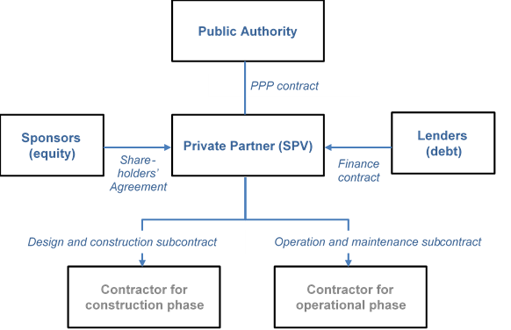
Phase 3 – Project procurement
Stage 1 – The tendering process
A typical PPP contractual structure

Slide 27
Phase 3 – Project procurement
Stage 1 – The tendering process
Manage interactions with tenderers through different phases of the competitive dialogue or procedure with negotiation
First phase, ensure common understanding of the tender invitation document, clarifications disclosed to all tenderers, good practice to keep record of meetings and issues raised
Second phase, meeting with tenderers in preparation of their final tender, confidentiality issues
Submission of final tender
Managing tenderer queries and requests for clarification from tenderers, using a defined communication protocol, rigorous management of process, swift replies, well stablished communication channel (web-based, e-mail)

Slide 28
Phase 3 – Project procurement
Stage 1 – The tendering process
Evaluation of tenders, using different award criteria
Lowest price
Easy to apply, mechanical
Doesn’t allow for qualitative considerations
MEAT (most economically advantageous tender), assessment of best price-quality ratio, a weighted mix of price and non-price criteria to reflect their relative importance
Non-price criteria in accordance with Directive 2014/24/EU: quality, technical merit, aesthetics, design, accessibility, innovation, qualification and experience of staff performing the contract, period of completion, technical assistance…

Slide 29
Phase 3 – Project procurement
Stage 1 – The tendering process
Evaluation of tenders to select the preferred tenderer, the process includes
Assess completeness of proposals submitted and formats used are according to rules of invitation to tender
Initial assessment of pass/fail criteria, solution meets all minimum technical requirements, costs and financial structure are consistent with the technical solution
Individual tenders assessed by project/tender team in accordance with the criteria and the weights set out in the tender documents
Ranking of tenders, identify the preferred tenderer and communicate to all parties involved

Slide 30
Phase 3 – Project procurement
Stage 2 – The PPP contract and financial close
After the selection of the preferred tenderer, a number of tasks must be performed before signing the PPP contract
Stage 2: PPP contract and financial close From selection of winning tender to contract award and signing of all PPP-related agreements
Steps | Key activities
Finalise PPP contract | Finalise/clarify/negotiate the PPP contract details with the preferred/successful tenderer. Make any agreed non-material changes to the PPP contract.
Conclude financing agreements | Lenders to the preferred/successful tenderer carry out their due diligence checks and confirm financing terms. With the preferred/successful tenderer, finalise the terms of the financing/ancillary agreements with the lenders.
Contract award and financial close | Issue notice to unsuccessful tenderers of intention to award the contract (standstill period). (Assuming no legal challenge) the PPP contract is signed along with all related agreements (contract close) and the financing agreement (financial close) All parties satisfy any remaining “conditions precedent” that are necessary to make the PPP contract effective.

Slide 31
Phase 3 – Project procurement
Stage 2 – The PPP contract and financial close
A note on “conditions precedent”: activities that the private partner is required to undertake before the PPP contract can take full effect

Slide 32
5. Final comments

Slide 33
Final comments
PPP is just one of several public procurement tools, a mean to and end and not an end o itself
The use of PPP based on objective criteria, qualitative and quantitative VfM
The lifecycle approach of PPP increases complexity and brings challenges, necessary to enhance capacity of public institutions
Different stages of preparing and procuring PPP, lead by stable well dimensioned capable public teams
Transaction advisers must add value to public teams, not substitute them in their tasks
Transparency and competition are key factors to maximise the value of a project from structuring to tendering (and contract execution)

Slide 34
Questions?

Slide 35
European PPP Expertise Centre
epec@eib.org
www.eib.org/epec
Twitter: @EpecNews
Fernando Crespo Diu
Principal Adviser
f.crespodiu@eib.org
+352 43 79 83 696
Knut Gummert
Adviser
k.gummert@eib.org
+352 43 79 82 757
35

