Slide 1
A Guide to the Qualitative and Quantitative Assessment of Value for Money in PPPs
Knut Gummert, Adviser
European PPP Expertise Centre
European Investment Bank
Tirana, Albania
11 October 2018
Notes:
In this presentation, I like to present you the ‘Guide to the Qualitative and Quantitative Assessment of Value for Money’. If you are involved in preparing or approving a PPP project – this document guides you to the main steps HOW TO CONDUCT AN VFM ASSESSMENT.
Application:
If you want to assess if a potential project would be suitable to be procured as a PPP (looking at the main project characteristics – a small checklist in this presentation). When your minister pushes, might provide information why not.
If you want to compare the procurement modes - e.g. PPP vs public procurement
If you want to compare private sector bids to identify the bid with the best economic value
For the purposes of this Guide, PPPs are defined as arrangements where public authorities and private partners collaborate to deliver public infrastructure assets and related public services that have traditionally been financed and delivered by the public sector. The definition of PPPs in this Guide refers both to projects that involve the public authority being responsible for payment for the service, usually on an availability basis (sometimes referred to as availability-payment PPPs) and those PPPs where the end-user pays for the service (often referred to as a ‘concession’).

Slide 2
Content
EPEC VfM Assessment Guide for the Western Balkans
What is Value for Money?
How, why and when to assess Value for Money?
Qualitative VfM Assessment Process
Quantitative VfM Assessment Process
Questions
Notes:
Having a look to the content of the presentation:
Introduction
Discussion what do we understand as Value for Money
The usage of VfM assessments
And a short descripotion both of a qualitative and quantitative assessment of VfM.

Slide 3
1. EPEC VfM Assessment Guide for the Western Balkans

Slide 4
Guidance documents throughout the project life cycle:
Phase 1
Phase 2
Phase 3
Phase 4
Project identification
Project preparation
Project procurement
Project implementation
A Guide to the Qualitative and Quantitative Assessment of VfM in PPPs
This document
A Guide to Preparing and Procuring a PPP project
PPP Procurement Handbook
A Guide to the Main Provisions of an Availability-based PPP Contract

Slide 5
Content of the Guide to the Assessment of VfM
The VfM Guide is divided in three main parts:
Introduction to VfM assessment which provides an overview of the general purpose, use and timing of a VfM assessment;
Qualitative VfM assessment which provides detailed guidance on evidence-based approaches to examining the suitability of the PPP delivery mode for a project; and
Quantitative VfM assessment which provides detailed guidance on quantitative approaches for the comparison of the VfM of delivery options, including the use of a public sector comparator (PSC).
Notes:
In developing this Guide, EPEC has focused in particular on:
Practicability: the Guide seeks to present both the benefits and constraints in carrying out a VfM assessment;
Good practice: the Guide builds on EPEC’s broad work and experience in collaborating with PPP practitioners in Europe to facilitate the development of PPP policies and the preparation of PPP projects and the various VfM assessment approaches used;
Alignment to the Region: the Guide takes into account the specific characteristics of the PPP market in the Western Balkans.
Target audience
This Guide is targeted principally at public officials responsible for identifying, developing and approving PPP projects. This audience comprises those officials working in the different public authorities including: project teams in procuring authorities required to apply VfM assessments to analyse and justify the PPP mode for a project, identify the main constraints and uncertainties and compare procurement options; approving authorities seeking to review VfM assessments as a part of their approval processes. These authorities could be located in the line ministry itself or a ministry of finance or economy; and officials in line ministries seeking to identify possible PPP projects and establish PPP infrastructure pipelines.

Slide 6
2. What is Value for Money?

Slide 7
What is Value for Money?
VfM captures the relationship between costs and value of a PPP procurement option:
Costs usually represents the cost over the life time of the project to deliver the associated value. These costs include availability payments by the authority and/or end-user fees as well as the authority’s costs of managing the project and its risks.
Value comprises the quality/service level and quantity of the service over the same period.
Notes:
Value - economic value to the society

Slide 8
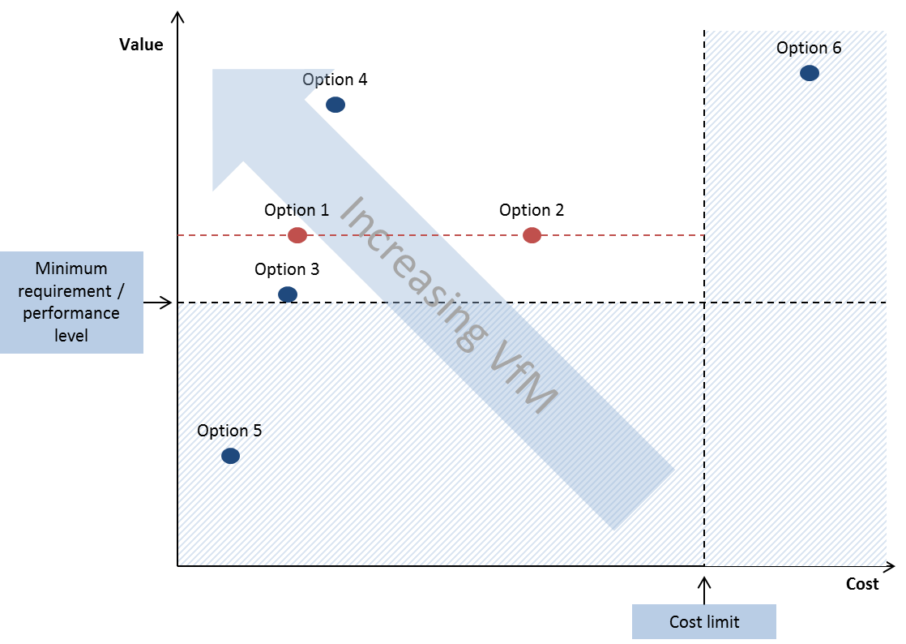
VfM as balance between Value and Costs
Notes:
Explain the graph: x/y axis with value and costs.
On the value axis, we have your minimum performance level (e.g. 200 beds in a hospital) AND on the cost axis, we have a cost limit above which the project would not be affordable or financially reasonable (e.g. EUR 50m).
The blue area is the NO GO area – investment/procurement options or project bids are not suitable.
2. Discussion:
Private sector bids 5 and 6 can be discarded as they do not fulfil the minimum service requirement (bid 5) or exceed the cost limit (bid 6).
Bid 3 is the least expensive of all the acceptable options, but its lower value suggests that the VfM of this option is lower than the VfM of bids 1 (more modern equipment enabling additional treatments) and 4 (e.g. laboratory or dialysis centre)
This illustrates an important feature of VfM, in that the cheapest bid may not necessarily offer the best VfM, which is usually referred to as the most economically advantageous tender (MEAT) option (vs. lowest price or highest initial payment).
A decision we all take everyday when we decide to buy something. Example – Buying shoes in Belgrade.

Slide 9
What are drivers of VfM in PPP projects?
Project teams with the knowledge, skills and experience to prepare, procure and monitor PPP projects and manage them throughout their life time to ensure VfM over the project’s life time.
A competitive bidding process between at least three capable bidders is a prerequisite for ensuring VfM. Competition incentivises efficiency gains through innovative approaches to deliver services, lower costs and/or improved asset/service quality.
Others:
  Existence of a reliable and transparent quality control and approval process throughout the project preparation, procurement and management.
  Active contract management to ensure the delivery of the services to the agreed quality and quantity
Notes:
Conditions
NOT
Project team: This capacity enables the team to challenge findings and recommendations of external consultants and, even more importantly, develop and negotiate the final contract to ensure the optimal ratio between delivered services and price/costs.

Slide 10
3. How, why and when to assess Value for Money?

Slide 11

Why assessing Value for Money?
Public authorities use VfM assessments to help aid decision-making including whether or not to proceed with:
preparing a project to be procured as PPP;
launching the competitive procurement process for the project as a PPP once it has been prepared as such; and
selecting a private sector bid to deliver the project in a PPP mode towards the end of the PPP procurement process.
PPP
VfM assessment is also used by governments to:
justify and communicate the procurement decision in a transparent way;
ensure accountability for the decision which must stand up to scrutiny;
ensure that the procurement decision for all projects is based on a consistent approach.
Notes:
More specifically for you in a public authority:
1 - 3

Slide 12
When to conduct a VfM Assessment?
Initial qualitative assessment
Approval
VfM assessments in EPEC member countries:
 | France | Germany | Netherlands | United Kingdom*
Identification phase |  | Yes | Yes |  | Yes
Preparation phase | Yes | Yes |  |  | Yes
Procurement phase | Yes | Yes | Yes |  | Yes (qualitative)
Notes:
SKIP SLIDE – ANOTHER GRAPH LATER
NOT
Phase 1: Suitability check and later initial assessment to start preparation
Phase 2: Continuous qualitative process of assessing VfM throughout the preparation phase
VfM assessment before launching the procurement process (qualitative / quantitative)
Phase 3: Confirmation of VfM before commercial close
Phase 4: Compare estimated and actual VfM

Slide 13
4. Qualitative VfM Assessment Process

Slide 14
Objective and content of a qualitative assessment
  Main objectives: Identify the motivations, assess the project’s suitability and identify constraints and risks.
  Content of qualitative VfM assessments: Often cover issues which assess the framework and the project’s suitability as a PPP:
Category | Sub-categories
Motivations | Key objectives or problems that using the PPP mode of procurement
Legal and regulatory framework | Public and political support Legal and regulatory PPP framework
Capacity of public and private parties | Public sector capacity and readiness Private sector capacity and interest
Project-specific issues | Project structure and size Risk identification, valuation and allocation Service requirements Non-financial benefits
Notes:
Discuss in detail – main aspects covered in qualitative checklists:
Political will – support of high level policy makers
Legal framework – existence of a PPP law, legal rights to establish a PPP company, transfer of public assets / or rights of use to the PPP company / provision of services (prison). Provisions which allow the gov to provide subsidies.
Public sector – Required financial and human resources knowledge and skills to manage pre and procurement process, financial model, ESIA, affordability assessment, understanding of management of transaction advisers.
Private sector: capacity – legal, financial and technical knowledge, experience, financial resources / size, and INTEREST – country and project risks. Access to finance to reasonable terms
Structure: bundle sufficient construction and maintenance/operation (to enable efficiency gains), duration \\ size – efficiency gains outweigh higher financing and transaction costs
Feasibility – feasibility study, cost and revenue assessment (CBA), affordability assessment
Risks – possible to identify, measure, price and allocate the main risks? Proven technology, interface risks
Service outputs – project address a long-term, predictable and stable public service need? Can the service be expressed in measurable output terms? Safe from rapid technological changes?
Non-financial benefits (NFBs) refer to socio-economic benefits to service users or wider society from an infrastructure investment. These benefits include accelerated asset and service delivery, enhanced service quality, wider social impacts and potentially higher quality operations and long-term maintenance.
Motivations: including benefits intrinsic to the PPP delivery model itself (e.g. accelerated service delivery, enhanced delivery (e.g. improved long-term maintenance), wider benefits (e.g. contestability/reform of public sector approaches to delivering infrastructure)

Slide 15
When to conduct a qualitative VfM assessment?
Process: Qualitative VfM Assessment
Project identification phase
Project preparation phase
Project procurement phase
Initial assessment
Assessment
Detailed Assessment
Notes:
VfM Assessment aims to ensure that PPP projects…
…achieve VfM through a continuous assessment throughout the preparation, procurement and contract management phases.
…assess VfM through periodic comparative exercises that can be broken down into two broad areas:
an ex ante VfM assessment informs a future decision such as whether or not to use PPP as a procurement option
an ex post VfM assessment to assess VfM during the operational period of the PPP

Slide 16
Qualitative VfM assessment (1)
Initial assessment (identification phase)
Content: A simple and effective assessment during the identification phase to screen a project’s suitability to deliver VfM as a PPP
The initial assessment reflects the limited amount of information and data available at the identification stage
Purpose: This assessment only serves the identify unsuitable projects. This avoids the unnecessary costs of assessing in detail projects that are intrinsically unsuitable to deliver VfM as a PPP (unsuitable project)
Next steps: Proceed with more detailed preparation of the projects as potential PPP (suitable project)
Notes:
SKIP

Slide 17
Legal and regulatory framework
 |  | Can the project be procured as a PPP within the existing legal framework?
 |  | Does the legal and regulatory framework permit the private sector to provide the public service?
 |  | Does the public authority have the required legal powers to prepare, procure and enter into the PPP contract and related agreements?
 |  | Do high-level policy makers and officials support the implementation of the project as a PPP?
 |  | Is there evidence that users & other relevant stakeholders support the project being procured as a PPP?
Public and private sector capacity
 | Does the public authority have access to the appropriate skills, experience and knowledge necessary to prepare, procure and manage the PPP?
 | Can the private sector provide access to the necessary skills/experience that are not readily available to the public sector?
 | Have similar PPP projects been successfully implemented in the country, or region over the last 5 years?
Project-specific characteristics
 | Does the project offer the opportunity to integrate the design, construction, financing, operation and maintenance of the infrastructure asset in order to reduce whole-life costs?
 | Are the transaction costs of preparing and procuring the project as a PPP justified in relation to the value of the project?
 | For smaller individual projects, are there opportunities to spread or reduce the overall transaction costs by bundling the project or using a programme approach?
 | Does the project address a long-term, predictable and stable public service need which is not expected to change significantly over the duration of the PPP contract?
 | Is it clear that there are no obvious benefits or synergies to be gained by extending the authority’s existing management of operations?
Notes:
Discuss in detail – main aspects covered in qualitative checklists:
Political will – support of high level policy makers
Legal framework – existence of a PPP law, legal rights to establish a PPP company, transfer of public assets / or rights of use to the PPP company / provision of services (prison). Provisions which allow the gov to provide subsidies.
Public sector – Required financial and human resources knowledge and skills to manage pre and procurement process, financial model, ESIA, affordability assessment, understanding of management of transaction advisers.
Private sector: capacity – legal, financial and technical knowledge, experience, financial resources / size, and INTEREST – country and project risks. Access to finance to reasonable terms
Structure: bundle sufficient construction and maintenance/operation (to enable efficiency gains), duration \\ size – efficiency gains outweigh higher financing and transaction costs
Feasibility – feasibility study, cost and revenue assessment (CBA), affordability assessment
Risks – possible to identify, measure, price and allocate the main risks? Proven technology, interface risks
Service outputs – project address a long-term, predictable and stable public service need? Can the service be expressed in measurable output terms? Safe from rapid technological changes?

Slide 18
Qualitative assessment (2)
  Qualitative assessment (preparation stage)
  This qualitative assessment is used to test the suitability of the PPP option more in detail
  The timing of the assessment is usually linked to approval stages during this phase (decision to launch the formal public procurement)
  The assessment is used as a static as well as dynamic tool to achieve and assess VfM
  In this stage, qualitative and quantitative assessments are often carried out simultaneously to assess VfM
Detailed qualitative assessment (procurement stage)
The qualitative assessment is used to reconfirm the suitability of the project to be delivered as a PPP
With a focus on the quality of the procurement process to ensure competition
Notes:
SKIP – only short intro :
Based on an increasingly more detailed checklist, public officials can conduct qualitative VfM assessments in the preparation and procurement phase.
These assessments are often combined with quantitative VfM assessments.

Slide 19
5. Quantitative VfM Assessment Process
Notes:
Guide offers

Slide 20
What are the objectives of a quantitative assessment?
A quantitative VfM assessment has the main objectives:
to compare a PPP option with a potential public procurement option (PSC) to determine the preferred procurement option,
to compare the VfM of actual private sector bids to identify the bid offering the best price-quality ratio (identify the preferred bidder), or
to compare a (preferred) private sector bid with the public sector comparator (PSC) (sense and affordability check)
Advantages of conducting a quantitative VfM assessment:
Obliges more analysis of costs (e.g. design, financing, construction, management, operation) and risks (pricing and allocation)
Development of a database of cost and risk information
Negotiating tool with private sector bidders
‘Sense’ and affordability check of private sector bids
Notes:
Advantages:
Detailed analysis and estimation of costs and risks
Development of a database with cost and risk information which facilitates the development of PPP projects in the future
Quantitative VfM assessment is carried out in a simultaneous and iterative process, where other analyses (e.g. feasibility studies, risk analysis, affordability assessment) inform the VfM process and vice versa

Slide 21
How to conduct a quantitative VfM assessment?
Stage1
Develop the risk-adjusted PSC cash flow model
Stage 2
Develop the PPP cash flow model
Conduct sensitivity analysis
Stage 3
Compare the NPVs of the two options
Preparation of a risk-adjusted cash flow model of the traditional procurement option - usually referred to as the Public Sector Comparator (PSC) or ‘Public Sector Benchmark’ (PSB).
Development of a cash flow model of the PPP procurement alternative to estimate the expected availability payments or user fees.
Compare the Net Present Value (NPV) of the PSC and PPP option. If the NPV of the PPP option is significantly less than the PSC, then the PPP offers better VfM.
Notes:
The cash flow model needs to include all costs (planning, design, financing, construction, maintenance, operation and rehabilitation) and revenues as well as their timing along with estimates for the value of all the relevant risks and adjustments to ensure neutrality between the public or private option (such as taxation).
This analysis could use many of the same cost inputs of the PSC, with costs adjusted for the cost of risks allocated to the private partner. It would also include potentially assumed innovation and efficiency gains deriving from the involvement of private sector skills and expertise and the costs of using private sector finance

Slide 22
Overview of the quantitative VfM assessment process
Public Sector Comparator (PSC) |  | Public-Private Partnership (PPP)
Stage 1 | Challenges to VfM assessment | Stage 2
Step 1 Develop the base PSC cash flow model including expected capital and operating/maintenance costs (and revenues of the project where relevant). | Lack of reliable cost information, especially operating costs, for PSC and PPP projects with the same service levels. | Step 1 Develop the PPP cash flow model based on expected capital and operating/maintenance costs and revenues for the PPP. Possible efficiency factors could be included.
Step 2 Develop the risk-adjusted PSC cash-flow model by adjusting project costs (and revenues) for risks. | Lack of reliable risk valuation data (probability and impact). Process is based on assumptions. | Step 2 Develop the risk-adjusted PPP model by adding transaction and contract management costs, and financing requirements.
Step 3 Adjust model to ensure competitive neutrality between the PSC and PPP options (e.g. for taxation). | Differences between theoretically assumed and actual tax arrangements. | Step 3 Determine the level of availability payments or end-user fees required by the private partner.
Step 4 Use a justified discount rate to discount the cash flows to get the NPV of the PSC. | Discount rate: choice of appropriate rate. Rate chosen has a significant impact on the outcome (higher rates tend to favour the PPP option). | Step 4 Use a justified discount rate (usually but not always the same as the one used for the PSC) to discount the sum of the availability payments or end-user fees to get the NPV of the PPP option.
Stage 3
Compare the NPVs of the PSC and PPP options
The difference in the NPVs can be small, limiting the reliability of the quantitative assessment as an input into the delivery option decision.
Notes:
SKIP – just link between this and the slide before
Table with a more detailed overview of a quantitative VfM assessment. The Guide discusses these steps in more detail – in particular the risk management including risk identification, pricing, allocation and monitoring.

Slide 23
What are the main constraints?
General constraints which often affect a VfM assessment include:
Limited PPP experience and knowledge within the responsible procuring authority or approving body in estimating risk-adjusted costs, modelling the private financing, developing a complex PSC and PPP cash flow model and calculating a risk adjusted Net Present Value (NPV) using an appropriate discount rate.
Lack of reliable long-term data on costs (in particular long-term operational expenditures), revenues and risks limits the reliability of the PSC and the private PPP cash flow model.
Selection of an adequate discount rate to calculate the NPV can have a defining impact on the assessment (high rates favor PPPs)
Due to these constraints, a positive result of the assessment can provide a false impression of reliability (science vs art)
Conducting a quantitative VfM assessment requires significant time and financial resources.
Notes:
Despite the drawbacks of quantitative VfM assessment, the assessment can still be an important part of an overall ex ante assessment of VfM combined with qualitative assessment i.e. it should be used to help inform the PPP procurement decision but not on its own to make the decision as the assumptions may be open the question, the result marginal and other non-quantifiable factors may also need to be taken into account in the overall decision.
Discount rates:
Financial perspective – based on the borrowing costs of the government (bonds with similar duration)
Socio-economic decision – based on economically based assumptions of the value / benefits of the investment (higher than financial perspective)
Investment perspective – based on the cost of capital for the project, often weighted average cost of capital
The calculation of the PPP and PSC should use the same discount rate.

Slide 24
How and when to use a quantitative assessment?
The use of quantitative VfM assessments should be influenced by the size and complexity of projects. Determinants on the use of quantitative VfM assessments:
larger and rather complex projects should be examined using qualitative and quantitative assessments, due to their large potential fiscal impact
for smaller projects, a simplified VfM assessment might be appropriate to reduce high transaction costs which otherwise might constrain projects’ affordability
for often implemented projects with a proven track record of delivering VfM, a simplified or mainly qualitative VfM assessment might be appropriate
Notes:
The costs and the requirement for data to conduct a quantitative VfM assessment might be relatively high in comparison to the overall project costs of small-ticket PPP projects.
Given the dominance of small PPPs in the Western Balkan region, a qualitative VfM assessment might be sufficient, together with the general analyses, such as technical and economic feasibility, affordability and risk analysis.
MORE AN ART THAN A SCIENCE

Slide 25
How to strengthen the VfM assessment process?
Establishing a specialised unit (e.g. a PPP unit) which supports procuring authorities or directly conducts the VfM assessment
Including a wider set of criteria in the assessment (e.g. a qualitative VfM assessment) instead of relying only on a quantitative assessment
Developing templates and standardised VfM assessment processes which assist less experienced procuring authorities and improve reliability, consistency and cost-efficiency of these assessments
Strengthening overall project quality control and approval processes

Slide 26
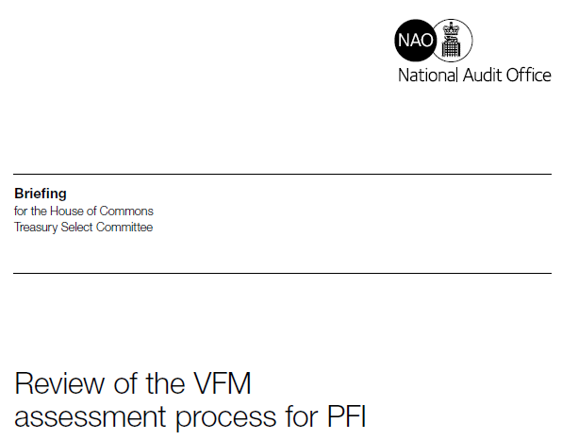
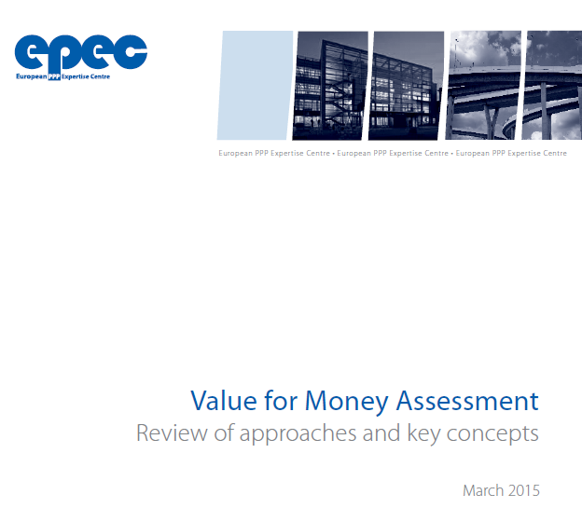
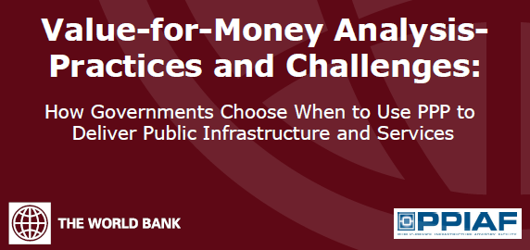
VfM reference documents
https://www.nao.org.uk/wp-content/uploads/2014/01/Review-of-VFM-assessment-process-for-PFI1.pdf
http://www.eib.org/epec/resources/publications/epec_value_for_money_assessment_en
http://documents.worldbank.org/curated/en/724231468331050325/pdf/840800WP0Box380ey0Analysis00PUBLIC0.pdf
26

Slide 27
Questions?

Slide 28
European PPP Expertise Centre
epec@eib.org
www.eib.org/epec
Twitter: @EpecNews
Fernando CRESPO DIU
Principal Adviser
f.crespodiu@eib.org
+352 43 79 83 696
Knut Gummert
Adviser
k.gummert@eib.org
+352 43 79 82 757
28

