Slide 1
Source: https://commons.wikimedia.org/wiki/File:Royal_Derby_Hospital_Facade.jpg
PPP Contract
Tirana, Albania
11 October 2018

Slide 2
Risk-reward relationship in PPP Projects by contract structure
High
Privatisation without regulation
Privatisation with regulation
Concession with availability, demand and revenue collection risks
Private sector reward
Concession with availability and demand risks
Concession with availability risk
Partnering/alliancing
Outsourcing
Service contract
Low
Low
High
Private sector risk

Slide 3
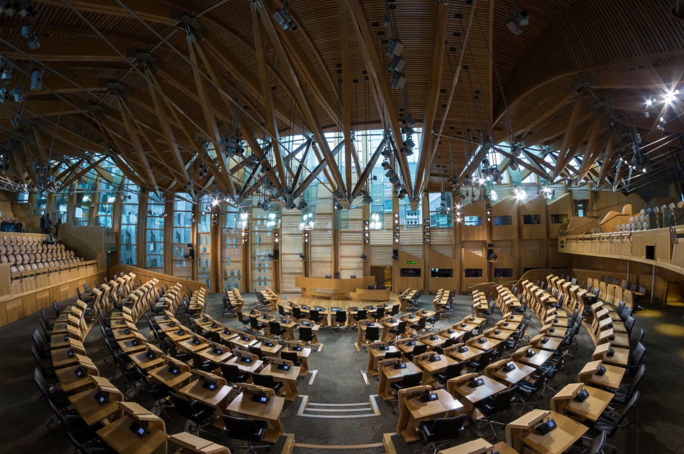
Lessons learned – risk allocation and procurement
Scottish Parliament
Budgeted cost: GBP 50 million
Actual cost: GBP 431 million
Delay: 20 months
PPP contract? No
Source: https://commons.wikimedia.org/wiki/File:Scottish_Parliament_Debating_Chamber_2.jpg

Slide 4
Successes - on time and on budget
M6 Toll, UK
53 year concession
Completed six weeks ahead of schedule
Completed on-budget
Approximately 50,000 vehicles a day in Q2 2017
Source:https://www.m6toll.co.uk/about-us/gallery/

Slide 5
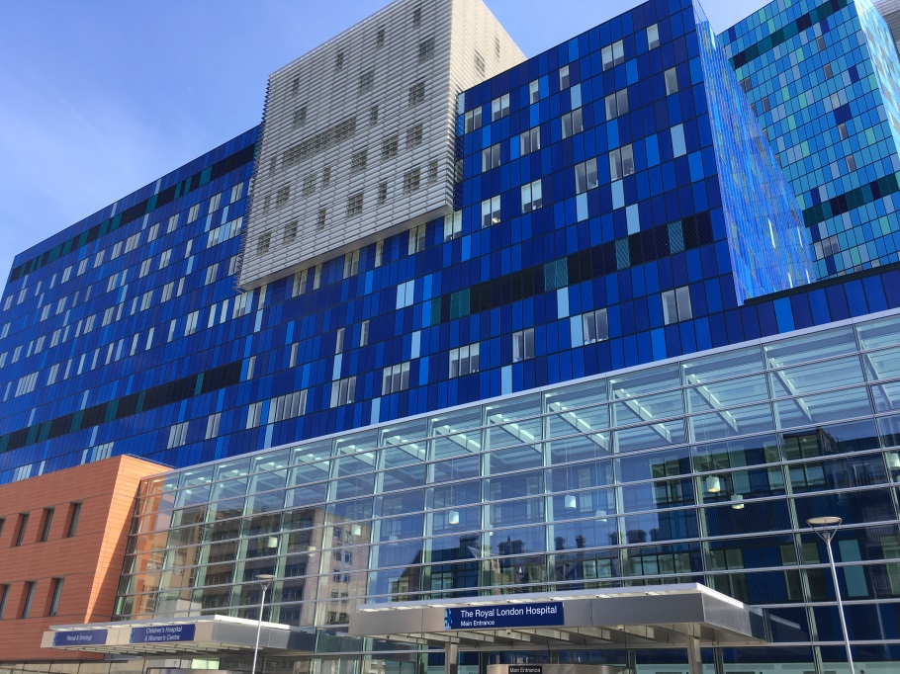
Successes - value for money saving
Barts and the London NHS Trust
New acute teaching hospital (The Royal London)
Redevelopment of Barts as a cancer and caridac centre of excellence
1,248 beds in total
Capital expenditure EUR 1,230,000,000
Value for money saving EUR 340,000,000
Concession period 42 years
Largest healthcare PPP project to date
Source: https://commons.wikimedia.org/wiki/File:Royal_London_Hospital_New.jpg

Slide 6
PPP Project Structure
Direct Agreements
Governmental Authority
Direct Agreement
Sponsors
Sponsor Support Agreement
Lenders
Concession Agreement / PPP Contract
100% ownership
Equity Contributions
Direct Agreements
Loan Agreement
Ownership
Project Company (Private Partner)
Construction Contract
FM Contract
Construction Contractor
Facilities Management Contractor
Subcontracts
Subcontracts
Subc. A
Subc. B
Subc. C
Subc. D
Subc. E
Subc. F

Slide 7
Construction Risks
Risk | Authority | Project Co | Contractor
Design |  | X | X
Ground Risk |  | X | X
Antiquities |  | X | X
Insurable FM |  | X | X
Changes | X
Force Majeure | X | X | X
Cost Over-run |  | X | X
Change of Law | X (Discrim) | X | X
Delay |  | X | X
Latent Defects |  | X | X
Insurance |  | X | X

Slide 8
Operational Risks
Risk | Authority | Project Co | Contractor
Changes | X
Performance |  | X | X
Change of Law |  | X
Increased Costs |  | X | X
Maintenance |  | X | X
Insurance |  | X
Force Majeure | X | X
Expropriation | X

Slide 9
PPP Contract or Concession Agreement
3
An agreement whereby one party who owns a right or asset (the “Authority”) permits another (the “Private Partner”) to exploit that right or asset and the Private Partner agrees with the Authority to provide a specific level of service for the benefit of the Authority for a “return”
1
Depending on sector:
Private Partner may receive fees
Private Partner may pay fee/royalty
2
3

Slide 10
Contents of a PPP Contract
Construction Phase
obligation to build to specification
obligation to build by fixed date
liquidated damages
termination for delay
right of Authority to vary specification

Slide 11
Contents of a PPP Contract (cont’d)
Operation Phase
obligation to provide specific level of service
right of Authority to carry out additional works
payment mechanics (indexation)
obligation to transfer asset back on expiry of concession – handback requirements

Slide 12
Time and/or money
If an adverse event occurs, there are four options in a concession:
No time extensions and no money
e.g. Private Partner breach
Money but no time
e.g. some variations
Time but no money
e.g. Force Majeure
Time and money
e.g. Authority breach

Slide 13
Risk Mitigants
Insurance
NB: availability and cost
Due diligence
“Pass the risk”
Sponsor support
Political risk insurance

Slide 14
Termination payments
International lenders look to be paid out in full on termination including on termination for Private Partner default (e.g. breach of PPP contract).
Standard in emerging markets projects (especially for jurisdiction without established record for successful PPP projects/insolvency risk)
In “boom time” some CEE precedent for pay-out on Private Partner default being limited to percentage of asset value (investment), but market has hardened
Some examples of no termination payment for Private Partner default but only in markets with:
long-established PPP track-record;
robust “step-in” rights for lenders; and
settled and predictable legal system.

Slide 15
Security and step-in rights
International practice shows that is not critical for Private Partner to own and create security over project tangible assets if:
Private Partner’s rights to use and exploit the assets is assured and can’t be interfered with;
lenders have ability to remedy Private Partner failures e.g. by taking over management of project or arranging for another operator to do so; and
lenders have good security over Private Partner revenues and over all its contract rights including concession agreement.
Security
Step-in Rights
Authorities now recognise that lenders can be their allies in policing Private Partner’s performance of its concession obligations. Direct agreement should help reinforce this alliance.

Slide 16
Traditional assumptions for PPP projects
PPP deals involve:
Direct agreements with the authority
Social
infrastructure and transport
Long term debt, fixed at close
A programme run by government
2
4
6
1
3
5
7
An SPV
90:10 debt: equity in a limited liability company
A standard contractual risk allocation

Slide 17
None of these assumptions is global
Some examples
Transmission capacity for African PPP projects
French concession businesses work without SPVs
Australian PPP does not have long-term debt
At least one Netherlands deal did not fix debt
The US has no PPP/P3 programme
Few, if any, countries enforce a risk allocation as rigidly as the UK
French PPPs have been closed without direct agreements

Slide 18
Contacts – Allen & Overy
Dan Cocker
Partner
Tel +48 22 820 6155
dan.cocker@allenovery.com

Slide 19
Questions?
These are presentation slides only. The information within these slides does not constitute definitive advice and should not be used as the basis for giving definitive advice without checking the primary sources.
Allen & Overy means Allen & Overy LLP and/or its affiliated undertakings. The term partner is used to refer to a member of Allen & Overy LLP or an employee or consultant with equivalent standing and qualifications or an individual with equivalent status in one of Allen & Overy LLP's affiliated undertakings.
WR5102216

